Slide 1
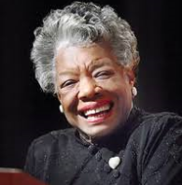
Maya Angelou
Leader, Activist, Essayist, Director, Writer, & Poet
Leadership & Communication – Elizabeth Swain

Slide 2
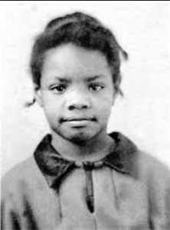
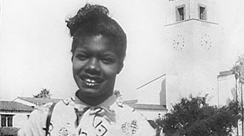
Early Life
Born in St. Louis, Missouri – Marguerite Annie Johnson
Raised in Stamps, Arkansas
Suffered trauma at the age of 7 and fell mute for five years
At age 13, she began to speak again
Studied dance and drama at San Francisco’s Leadership School
At the age of 16, she dropped out of high school to become the first female cable car conductor in San Francisco and had her first child, Guy.
Maya Angelou at Age 7 – Photo from Academy of Leadership.org
*Source: Academy of Achievement – academyofachievement.org/achiever/maya-angelou/
Maya Angelou at Age 14 – Photo from Academy of Leadership.org

Slide 3
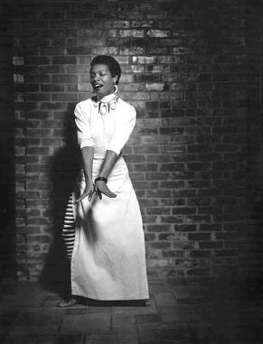
1950’s
In 1952, she married a Greek sailor named Anastasios Angelopulos
Her marriage did not last throughout the 50’s, however her career flourished during this time with accomplishments such as
A cast member in the European production of Porgy and Bess in 1954 and 1955
Studied dance with Martha Graham and performed with Alvin Ailey on television variety shows
Recorded her first album Calypso Lady in 1957
*Source: Academy of Achievement – academyofachievement.org/achiever/maya-angelou/

Slide 4
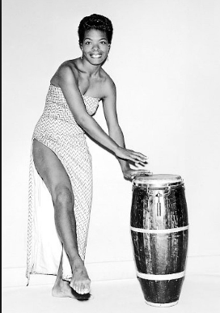
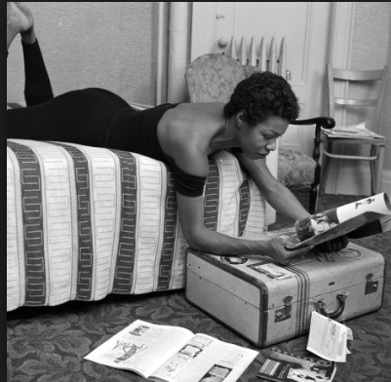
1960’s
Writing career was thriving by this point and Maya moved to NYC
Joined the Harlem Writers Guild and performed in Off-Broadway productions
Moved to Cairo, Egypt with South African civil rights activist Vusumzi Make and worked as the English Language editor for The Arab Observer
Later moved to Ghana where she joined a group of African American expatriates and taught at the University of Ghana’s School of Music and Drama
*Source: Academy of Achievement – academyofachievement.org/achiever/maya-angelou/

Slide 5
Insert Quote

Slide 6
Activism
During one of Malcom X’s visits to Ghana, Maya Angelou met him and began to correspond with him helping his views evolve from the racially polarized thinking of his youth to the more inclusive vision of his maturity
Returned to the U.S. in 1964 to help Malcom X build his new organization however shortly after her arrival he was assassinated and his plans for an organization never came to fruition
Began to work with Dr. Martin Luther King to help as the Northern Coordinator for the Southern Christian Leadership Conference
After Dr. Martin Luther King’s assassination, she began to focus on her writing with the encouragement of author James Baldwin
In 1970 – I Know Why the Caged Bird Sings was published making her a nationally renowned figure overnight

Slide 7
Insert Quote

Slide 8
Maya Angelou – Relationship Way
Devotion to relationships
Cultivate Potential
Optimistic
Growth Oriented
Inspirational
Expressive
Writing and Speaking with a flair
Assumes creative roles
Seeks harmony
Sensitive
Imaginative
Romantic
“I’ve learned that people will forget what you said, people will forget what you did, but people will never forget how you made them feel.”
-Maya Angelou
*Personality Resource International Canada, 2006

Slide 9
Insert Quote

Slide 10
Adaptive Leadership
Help people change and adjust to new situations
More about the adaptation of the followers, not the leaders
Leader encourages others to problem solve
*Northouse, P.G. Leadership, Theory, and Practice, 7th ed. (2016) p. 261, Thousand Oaks, CA: SAGE

Slide 11
Manger / Leader Qualities
Manager
Leader
Direct Operations
Develop the Organization
Reinforce Performance
Communicate Organization Direction
Develop Key Relationships
Inspire Others
*Leader – Manager Profile Assessment, HRDQ

Slide 12
Insert Quote

Slide 13
Affiliative Leadership
How it builds resonance
Creates harmony by connecting people to each other
Impact on Climate
Positive
When Appropriate
To heal rifts in a team, motivate during stressful times, or strengthen connection.
*Northouse, P.G. Leadership, Theory, and Practice, 7th ed. (2016) p. 261, Thousand Oaks, CA: SAGE

Slide 14
Manger / Leader Qualities
Manager
Leader
Direct Operations
Develop the Organization
Reinforce Performance
Communicate Organization Direction
Develop Key Relationships
Inspire Others
*Leader – Manager Profile Assessment, HRDQ

Slide 15
Areas of Strength
Powerful writing
Powerful speech
Ability to create relationships with other
Ability to build strong relationships with the community through her artistic work
Ability to work with leaders and adapt to changing conditions

Slide 16
Areas for Development
Allowing for

Slide 17
Honors and Awards

