Slide 1
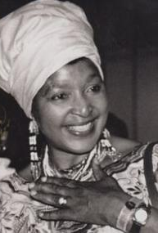
Winnie Madikizela-Mandela
The Mother of The Nation

Slide 2
Contents
Life
Early Years
Education
Early Career
Personal Life
Her plight
Activist
Her Plight
Leadership
Authentic Leader
True Color Assessment
Conclusion
Questions
References

Slide 3
Early Years
Born Winnie Madikizela September 26 1936 in Mbongweni, Transkei, Easter Cape, South Africa.
Her mother was a science Teacher and her Father was a school principal that later became the minister of the Transkei Government’s Forestry and Agriculture Department.
She came face to face with apartheid when she was 9 years old.

Slide 4
Apartheid
Racial segregation and white supremacy had become central aspects of South African policy long before apartheid began. The controversial 1913 Land Act, passed three years after South Africa gained its independence, marked the beginning of territorial segregation by forcing black Africans to live in reserves and making it illegal for them to work as sharecroppers. Opponents of the Land Act formed the South African National Native Congress, which would become the African National Congress (ANC).
A policy of system of segregation or discrimination on grounds of race.
Became Law in 1948 and the law was amended in 1991.

Slide 5
Education
Winnie was able to benefit from an education that was on the same level as her White peers due to the Bantu Education.
Studied at Shawsbury, Methodist Mission school. There she matriculated and distinguished herself as a person with exception leadership qualities.
In 1953 She went to school in Johannesburg where she was admitted to the Jan Hofmeyr School of Social Work. She completed her degree in 1955 finishing at tope of her class.
Offered a scholarship to continue her Study in USA, but she denied it. To continue working in South Africa against Apartheid.

Slide 6
Early Career
Offered and accepted a position of medical social worker at the Baragwanath Hospital in Johannesburg. Making her the first qualified, black member of staff to fill that position.
Making a name for herself with her research as a social worker to establish the rate of infantile mortality, which at that time was 10 deaths for every 1,000 births.
She was always politically interested, and involved in protests and activist activities.

Slide 7
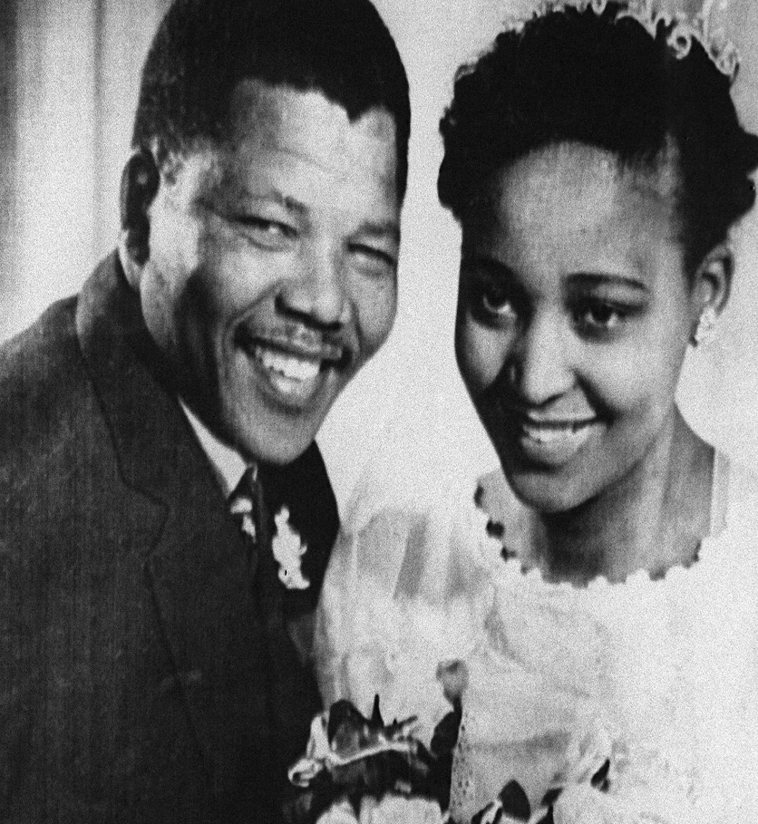
Personal Life/ Nelson Mandela
In 1956 she met Nelson Mandela and 2 years later they were married on June 14, 1958 and had 2 daughters (Zenani and Zindziawa).
Nelson Mandela was found not guilty of Treason in the Treason Trials on March 29, 1961, but soon after went into hiding.
In 1962 he was captured and was found guilty in conspiring to overthrow the government. He was sentenced to life in Prison. Nelson Mandela would spend 27 years in prison before he would be released.

Slide 8
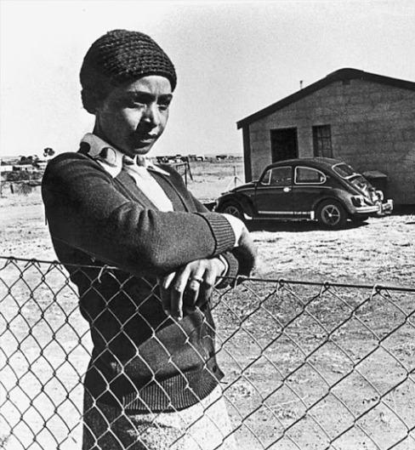
Her Plight
On December 28, 1962 she was given Banning restrictions of her movements throughout the magisterial district of Johannesburg.
She was not allowed to enter any education premises and barred from attending any event where more than 2 people were present.
In May 1963 Nelson was moved to a new Prison where Winnie travelled 1400 km (869 miles) from Johannesburg to Cape Town, the couple were allowed to meet for just 30 minutes, separated by dual wire mesh, no seats, and a security detail in easy listening distance.
In 1965 Her banning became more stringent.
She was only allowed out from Dusk until Dawn
She was only allowed within her neighborhood
On May 12, 1969 During a police raid Winnie was taken from her children and made to sped 491 days in solitary confinement she was released September 14, 1970.
In 1976 she was exiled to a suburban of Johannesburg, Brandfort 100km (62 miles) from Soweto for 5 years.

Slide 9
Her Plight (cont.)
During her banishment the police raids were relentless, with intrusions into her home sometimes happening up to four times a day.
Her house was routinely burgled, vandalized and even bombed.
During this time, Winnie became something of a lightning rod for South Africa’s disenfranchised youth. To the Apartheid regime she became a significant political figure in her own right, as opposed to merely being the feisty wife of Nelson Mandela
During her Banishment She established a local gardening collective, a soup kitchen a mobile health unit, a day care center; an organization for orphans and juvenile delinquents and a sewing club.

Slide 10
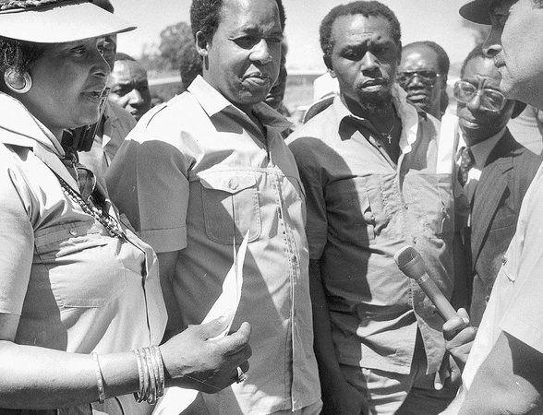
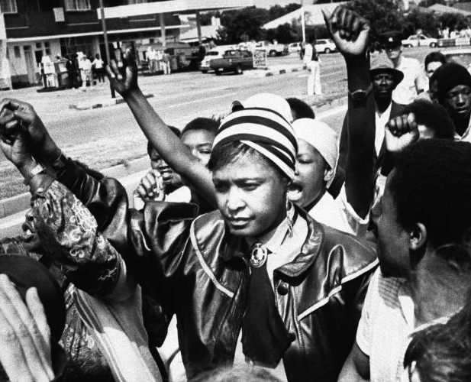
Activist/ Late Career
Continued to protest and raise awareness of the inequalities of Apartheid.
Became an Advocate and carried on political activity on Nelson Mandela’s behalf.
She was the Head of ANC’s Social Welfare in 1990
Elected President of the ANC’s Women’s League in 1993
Was elected Minister of arts, culture, science and technology, in 1994-1995
Reelected to Parliament in 1999, but resigned from her post in 2003 when convicted of fraud.

Slide 11
Conflicts
Mandela United Football Club
It was an organization to help disenfranchised youth to feel at home, organize and socialize.
The organization turned into a combative youth organization who were against apartheid, to over throw the government and to terrorize those who agreed with them.
James “Stompie” Sepei a 14 year old who was found murdered. Winnie was indicted for his murder, cleared of the charges, but sentenced to 5 years in prison on counts of kidnapping and accessory to assault. On appeal the courts ordered her to spend 2 years suspended sentence and pay a fine of 15 000 Rands ( $1,252.42 US)

Slide 12
Conflicts
Convections/ Indictments/ Controversies
Speech in Munsieville In 1986
Her speech was controversial in that she was endorsing an act called “Necklacing” her Quote "Together, hand in hand, with our matches and our necklaces, we shall liberate this country."
Human Rights Violations
In 1996 The Truth and Reconciliation Commission issued a warrant for her to appear in front of the Human Rights Violations Committee.
Charges of Fraud
She was convicted on charges of fraud in 2003 and theft stemming from her involvement with fraudulently obtained bank loans, many of which benefited economically disadvantaged persons. She was partially vindicated a year later when the conviction for theft was overturned because she had not recognized any personal gain from her actions.

Slide 13
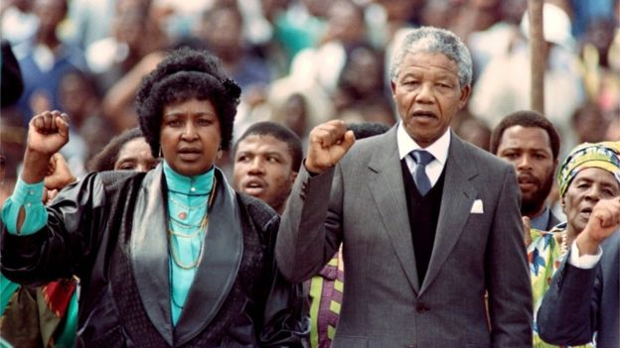
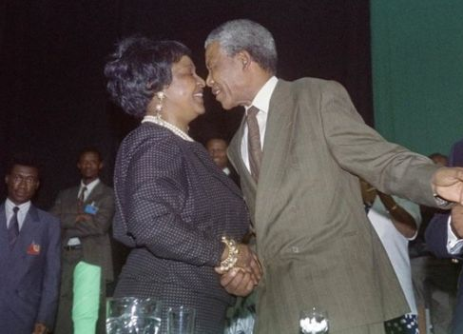
Conflict (cont.)
Marriage
Nelson Mandel was released in February 11, 1990
The couple was reunited after close to 30 years of separation
Her Conflicts were being publicized and she was becoming a target
Nelson Mandela and Winnie Separated in April 13 1992
Nelson Mandela Became President of South Africa May 10, 1994
In August 1995 Nelson instituted divorce proceedings
In March 1996 the Divorce was finalized
Nelson Mandel Died on December 5, 2013

Slide 14
Time Line
1936
Winnie Mdikizela was born
1956
Met Nelson Mandela
1958
Married N. Mandela
1961
N. Mandela Sentenced Life in Prision
1962
W. Mandela 1st Banning
1963
N. Mandela Moved to new Prision
1965
Banning more Sevre
1969
Arrested spends 492 days in Jail
1970
Released from prison
1973
Arrested again 6 months in prision
1975
Banning Order expired
1976
Exiled to Brandfort
1985
Returned to Johannesburg
1986
ControversialSpeech
1990
N. Mandela Released from Prision
1992
N. Mandela and W. Mandela Official Seperate
1994
N. Mandela Becomes President of South Africa
1995
W. Mandela loses cabinet position and Divorce proceedings begin
1996
Divorce Finalized
2013
N. Mandela Dies
12/5/13
2018
W. Mandela Dies, 4/2/2018

Slide 15
AUTHENTIC LEADERSHIP
Characteristics (Practical Approach)
Persective
Passion Purpose
Behavior Values
Compassion Heart
Consistency Self-Discipline
Connectedness Relationships
Intrapersonal perspective –
Self- knowledge
Self- regulation
Self- concept
Life experiences and the meaning he or she attaches to those experiences as being critical to the development of the authentic leader.

Slide 16
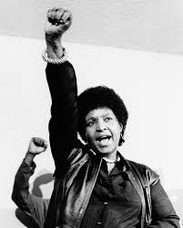
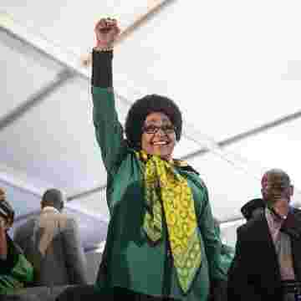
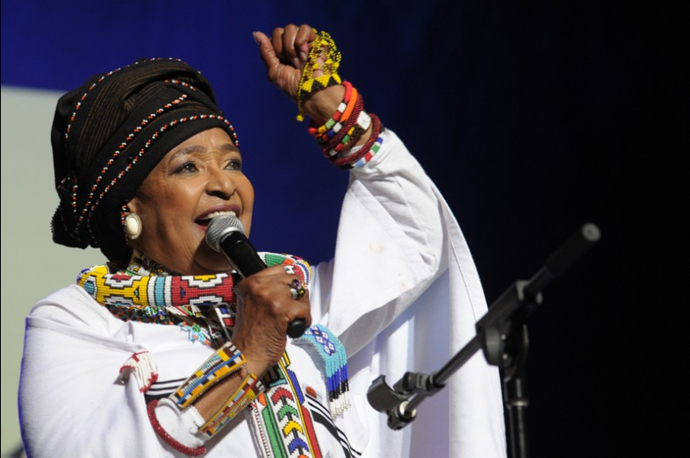
AUTHENTIC LEADERSHIP
Factors that Influence Leadership
Confidence
Hope
Optimism
Resilience

Slide 17
True Color Assessment
Action Way – Winnie Mandela
Logical Way – Keena Jones
Needs Independence
Need Freedom
Needs Change and Results
Risk taker
Spontaneous
Appears confident
Values Independence
Need Autonomy
Need Accuracy
Need time to think
Logical and Rational
Competent and knowledgeable

Slide 18
True Colors cont.
Action Way – Winnie Mandela
Logical Way – Keena Jones
Perception
Disobeys Rules
Uncontrollable
Irresponsible
Resists Decisions
Self- analysis
Flexible and Adaptable
Proficient and capable
Good Negotiator
Sees Shades of gray
Perception
Aloof, unfeeling
Unrealistic
Unfair
Devaluating Relational aspects
Self- Analysis
Objective and creative
Eminently Responsible
Rational
Visionary

Slide 19
Conclusion
In 2016 Madikizela-Mandela was conferred an Order of Luthuli in Silver for her outstanding contribution to the fight for the liberation of the people of South Africa
In 1985 Received the Robert F. Kennedy Humanitarian Award
In 1985 received the Third World Prize
Winnie Madikizela- Mandela Remains a enigmatic figure in South African Society and History.
Died Monday, April 2, 2018
"To those who oppose us, we say, 'Strike the woman, and you strike the rock'." – 1966
"If you are to free yourselves you must break the chains of oppression yourselves. Only then can we express our dignity, only when we have liberated ourselves can we co-operate with other groups. Any acceptance of humiliation, indignity or insult is acceptance of inferiority." – 1976

Slide 20
QUESTIONS?

Slide 21
References
http://www.sahistory.org.za/people/winnie-madikizela-mandela
http://www.sahistory.org.za/article/history-apartheid-south-africa
Mandela, W. (2013). 491 Days Prisoner 1323/69
https://www.biography.com/people/winnie-mandela-9397037
https://www.history.com/topics/apartheid
https://www.britannica.com/biography/Winnie-Madikizela-Mandela
http://www.saha.org.za/ecc25/ecc_under_a_state_of_emergency.htm

Slide 22
References
Northouse, P. (2016). Leadership : Theory and Practice.
Pieterse, A., & Roodt, D. (Directors). (2017). Winnie [Motion Picture]
https://www.encyclopedia.com/people/social-sciences-and-law/social-reformers/winnie-madikizela-mandela.

